Slide 1
Distortion and Veto Rules

Slide 2
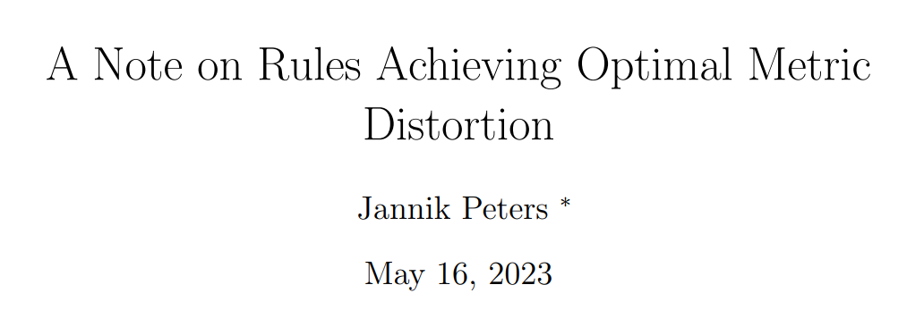
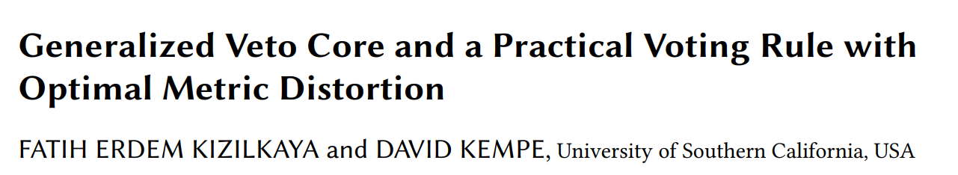
(2025)
(Feb 2025)

Slide 3
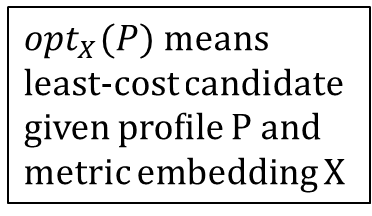
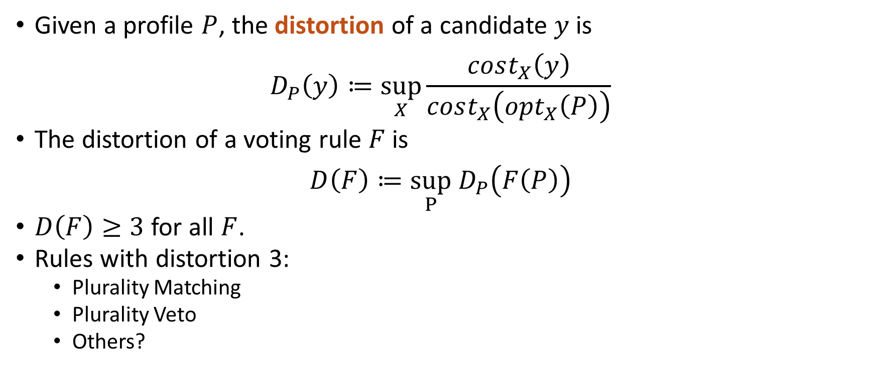
Review: Distortion
Given a profile $P$, the distortion of a candidate $y$ is
$$D_{P}\left(y\right)≔\sup_{X}{\frac{cost_{X}\left(y\right)}{cost_{X}\left(opt_{X}\left(P\right)\right)}}$$
The distortion of a voting rule $F$ is
$$D\left(F\right)≔\sup_{P} D_{P}\left(F\left(P\right)\right)$$
$D\left(F\right)≥3$ for all $F$.
Rules with distortion 3:
Plurality Matching
Plurality Veto
Others?
$opt_{X}(P)$means least-cost candidate given profile P and metric embedding X

Slide 4

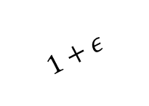


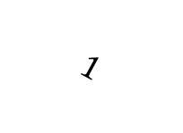


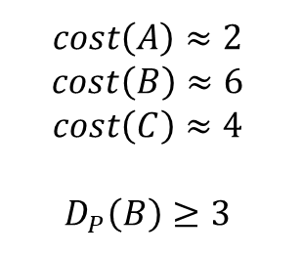
Review: Distortion
B
$$1−ε$$
x1 | x1 | x1
A | B | C
B | C | A
C | A | B
$$1+ε$$
2
$$1$$
$$P =$$
A
C
1
$$1+ε$$
$$1$$
3
What is $D_{P}\left(B\right)$?
$$cost\left(A\right)≈2 \\ cost\left(B\right)≈6 \\ cost\left(C\right)≈4$$
$$D_{P}\left(B\right)≥3$$

Slide 5
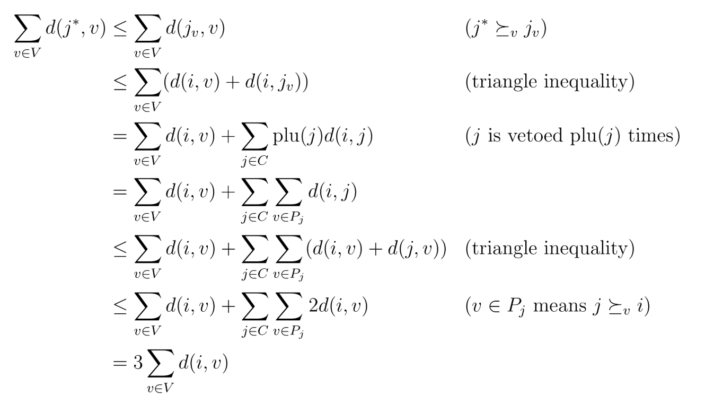


Review: Plurality Veto & Plurality Matching
Plurality Matching (Gkatzelis, Halpern, and Shah 2020):
The domination graph $G(y)$ of candidate $y$ is bipartite between $V$ and $C$, with an edge $v→c$ iff $v$ weakly prefers $y$ to $c$.
A plurality matching is a subgraph such that the degree of each voter is 1 and the degree of each candidate is their plurality score.
PM: $y$ wins iff $G(y)$has a plurality matching.
Plurality Matching
has distortion 3:
Same proof as PV

Slide 6
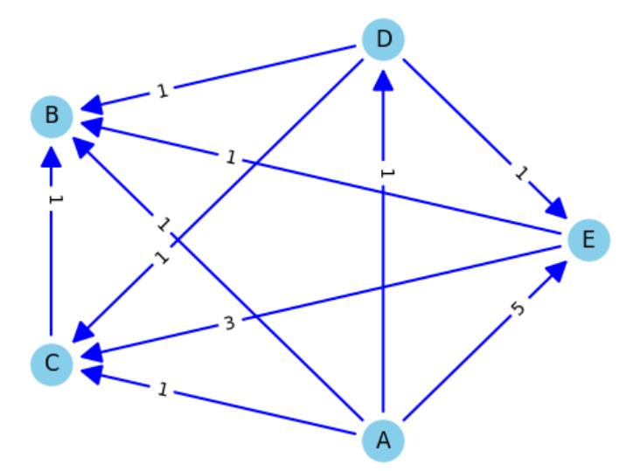
Example Election:
x2 | x2 | x2 | x1
D | C | B | B
A | A | A | E
E | E | D | C
C | D | E | D
B | B | C | A
Arguments for A:
Condorcet
Borda
Arguments for B:
Plurality
Arguments for C,D,E:
Plurality Matching

Slide 7
Review: Plurality Veto & Plurality Matching
Plurality Matching (Gkatzelis, Halpern, and Shah 2020):
The domination graph $G(y)$ of candidate $y$ is bipartite between $V$ and $C$, with an edge $v→c$ iff $v$ weakly prefers $y$ to $c$.
A plurality matching is a subgraph such that the degree of each voter is 1 and the degree of each candidate is their plurality score.
PM: $y$ wins iff $G(y)$has a plurality matching.
x2 | x2 | x2 | x1
D | C | B | B
A | A | A | E
E | E | D | C
C | D | E | D
B | B | C | A
x2 | x2 | x2 | x1
D | C | B | B
A | A | A | E
E | E | D | C
C | D | E | D
B | B | C | A
A
B
C
D
E

Slide 8
Review: Plurality Veto & Plurality Matching
Plurality Veto (Kizilkaya and Kempe 2022):
Every candidate begins with “points” equal to their plurality score.
Voters are ordered.
In order, each voter takes one point away from their least-favorite candidate who still has points.
The last candidate to hit 0 points is the sole winner.
x2 | x2 | x2 | x1
D | C | B | B
A | A | A | E
E | E | D | C
C | D | E | D
B | B | C | A
PV is a special case of PM (connecting each voter with their veto makes a matching).
However, not all PM winners can win PV.

Slide 9
 | PM | PV
Distortion 3 | Yes | Yes
Condorcet | No | No
Majority Fair | Yes | Yes
Unanimity Fair | No | Yes
Pareto Efficient | Yes | Yes
Monotonic | Yes | Yes
Spoiler-proof | No | No
Single-winner | No | Yes
Easy to explain | No | Yes
Anonymous | Yes | No

Slide 10
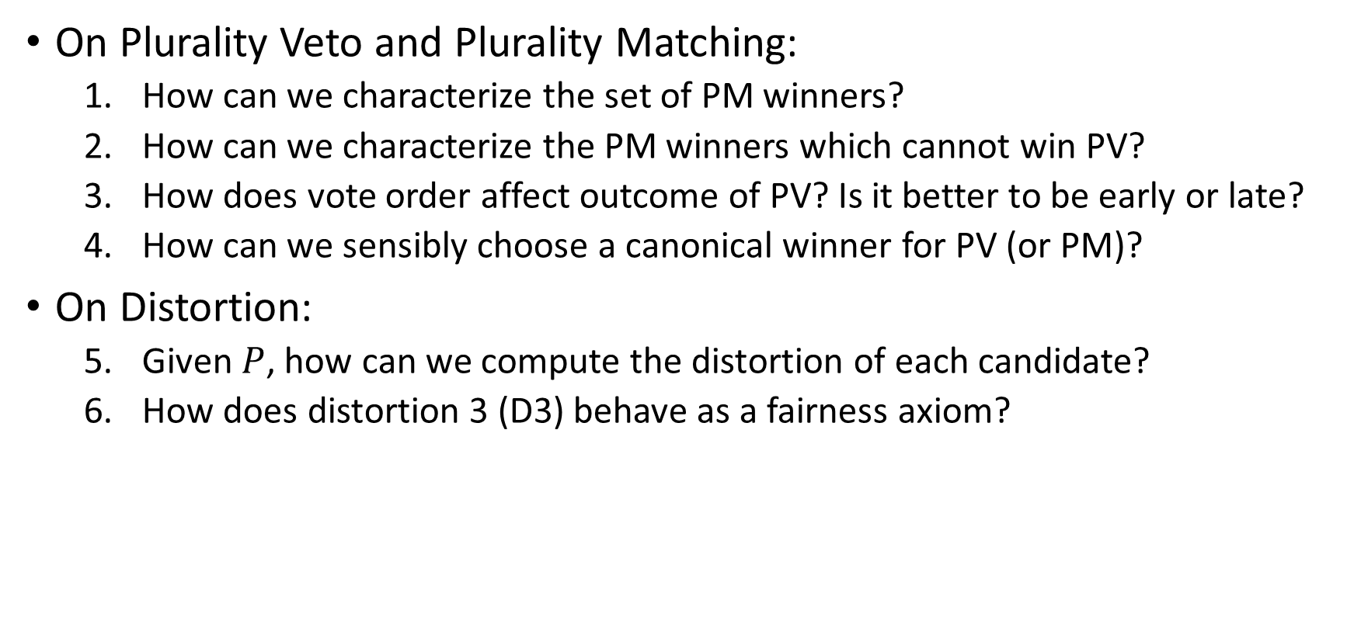
Questions
On Plurality Veto and Plurality Matching:
How can we characterize the set of PM winners?
How can we characterize the PM winners which cannot win PV?
How does vote order affect outcome of PV? Is it better to be early or late?
How can we sensibly choose a canonical winner for PV (or PM)?
On Distortion:
Given $P$, how can we compute the distortion of each candidate?
How does distortion 3 (D3) behave as a fairness axiom?

Slide 11
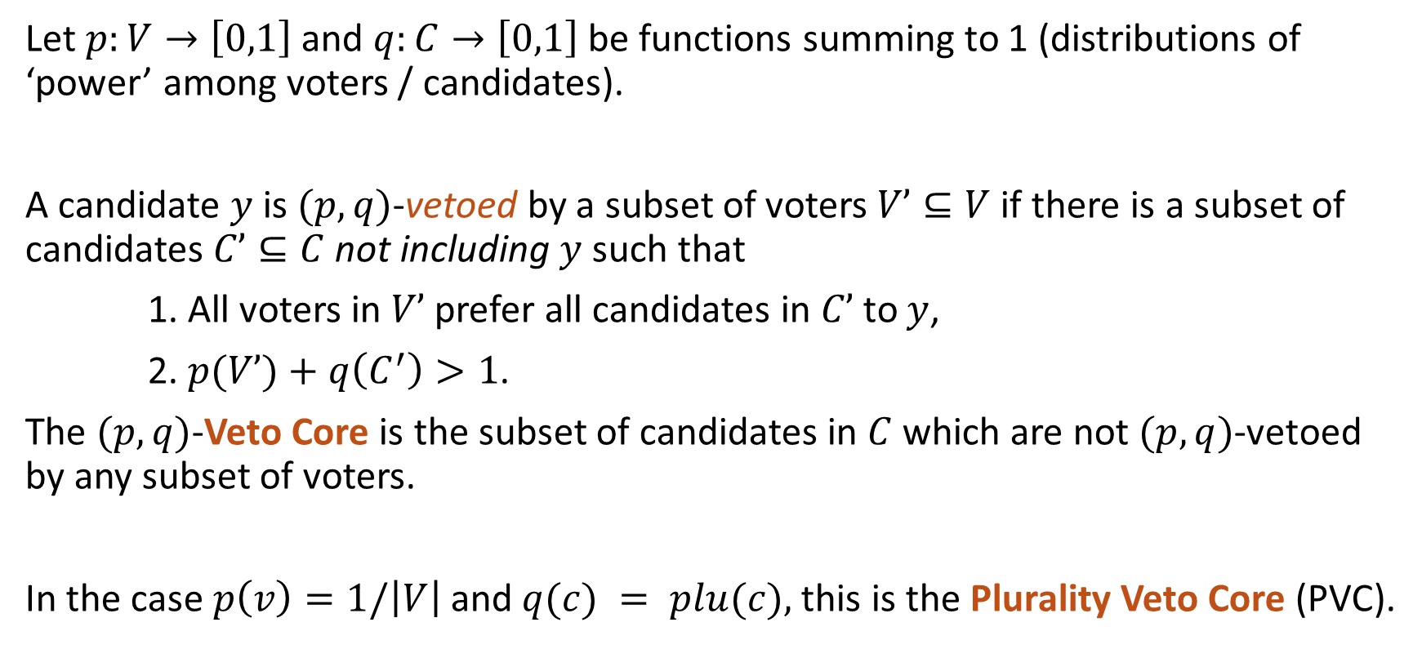
Q1: How to characterize PM winners?
Let $p:V→\left[0,1\right]$ and $q:C→\left[0,1\right]$ be functions summing to 1 (distributions of ‘power’ among voters / candidates).
A candidate $y$ is $(p,q)$-vetoed by a subset of voters $V’⊆V$if there is a subset of candidates $C’⊆C$not including $y$ such that
1. All voters in $V’$prefer all candidates in $C’$to $y$,
2. $p(V’)+q\left(C^{′}\right)>1$.
The $(p,q)$-Veto Core is the subset of candidates in $C$which are not $(p,q)$-vetoed by any subset of voters.
In the case $p\left(v\right)=1/\left|V\right|$ and $q(c) = plu(c),$this is the Plurality Veto Core (PVC).

Slide 12

Q1: How to characterize PM winners?
Theorem (Kizilkaya Kempe 2025):
$y$ is in the PVC $⟺G(y)$ has a plurality matching.
Proof: Hall’s marriage theorem.

Slide 13
Q2: How to characterize PM - PV?
Serial Veto (Kizilkaya Kempe 2025):
Order voters in some way.
Give candidates one point for each first-place vote.
All candidates are initially in contention, even those with 0 points.
Vetoing a 0-point candidate knocks them out and doesn’t expend a veto.
x2 | x2 | x2 | x1
D | C | B | B
A | A | A | E
E | E | D | C
C | D | E | D
B | B | C | A
Interesting fact: the SV winner set (for a given ordering of voters) is convex in any metric embedding

Slide 14
Q2: How to characterize PM - PV?
Theorem (Kizilkaya Kempe 2025):
In each instance of SV, the winners share a single plurality matching.
The set of possible SV winners is exactly the set of PM winners.
Proof:
x2 | x2 | x2 | x1
D | C | B | B
A | A | A | E
E | E | D | C
C | D | E | D
B | B | C | A

Slide 15
Q3: How does vote order affect PV?
As a voter, where is the best place to be in the vote-order?
Answer: Last.
Is it always better to be later?
Answer: ???

Slide 16
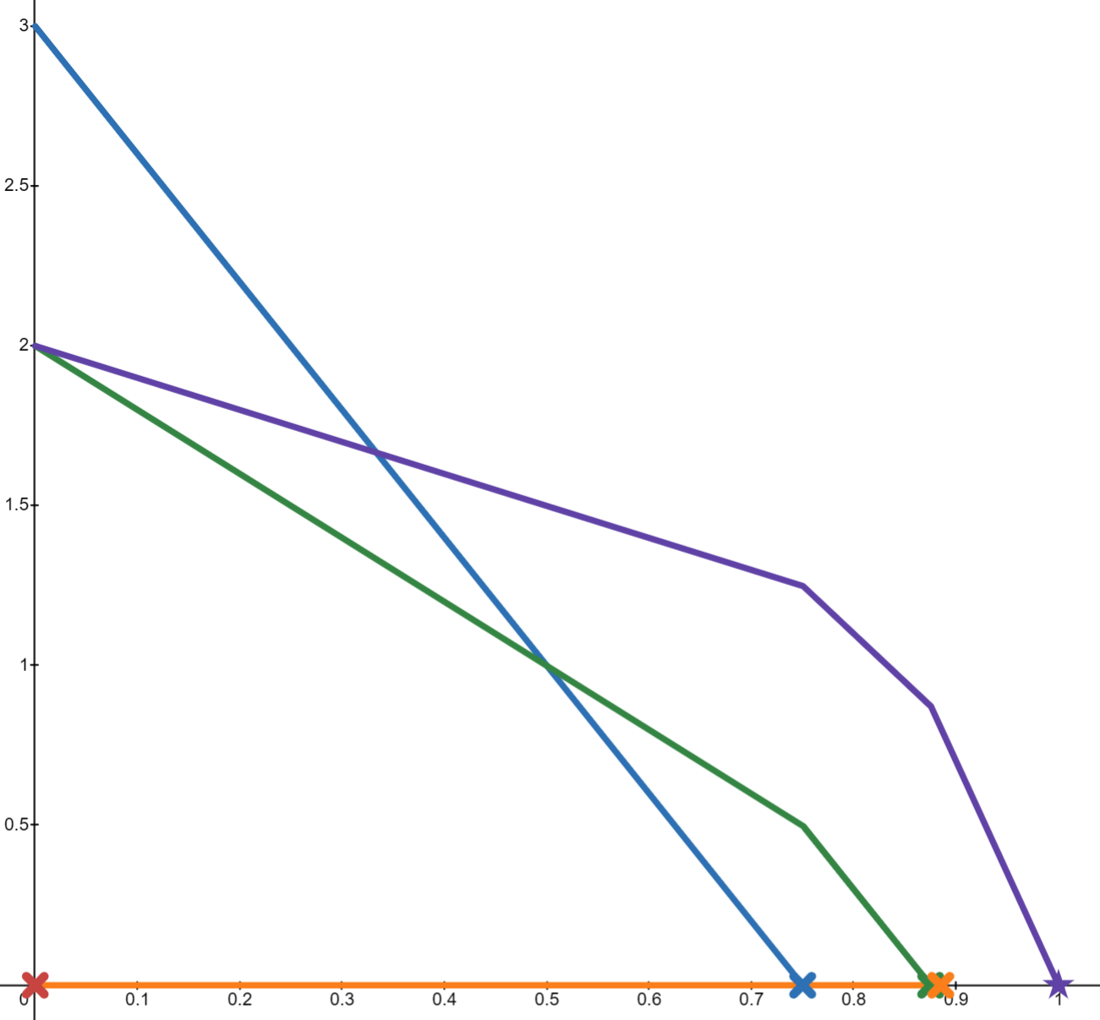
Q4: Choosing a canonical PV/PM winner
Simultaneous Plurality Veto (Kizilkaya Kempe 2025):
Candidates begin with points equal to their plurality score
From time 0 to 1, all voters drain points from their least-preferred candidate remaining at a rate of 1 point / second
Like SV, a candidate is eliminated if anyone vetoes them while at 0 points
x2 | x2 | x2 | x1
D | C | B | B
A | A | A | E
E | E | D | C
C | D | E | D
B | B | C | A
B
D
C
A
E

Slide 17
Q4: Choosing a canonical PV/PM winner
x2 | x2 | x2 | x1
D | C | B | B
A | A | A | E
E | E | D | C
C | D | E | D
B | B | C | A
 | x2 | x2 | x2 | x1
A | 0 | 0 | 0 | 0*
B | ¾ | ¾ | 0 | 0
C | 1/8 | 0 | 7/8 | 0
D | 1/8 | 1/4 | 1/8 | 1
E | 0* | 0 | 0* | 0
B
D
C
A
B
C
D
E
A
E

Slide 18
 | PM | PV | SPV
Distortion 3 | Yes | Yes | Yes
Condorcet | No | No | No
Majority Fair | Yes | Yes | Yes
Unanimity Fair | No | Yes | No
Pareto Efficient | Yes | Yes | Yes
Monotonic | Yes | Yes | Yes
Spoiler-proof | No | No | No
Single-winner | No | Yes | Probably
Easy to explain | No | Yes | Yes
Anonymous | Yes | No | Yes

Slide 19




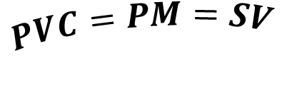
x2 | x2 | x2 | x1
D | C | B | B
A | A | A | E
E | E | D | C
C | D | E | D
B | B | C | A
$$C$$
$$D3$$
A
$$PVC=PM=SV$$
$$PV$$
E
C
D
$$SPV$$
B

Slide 20
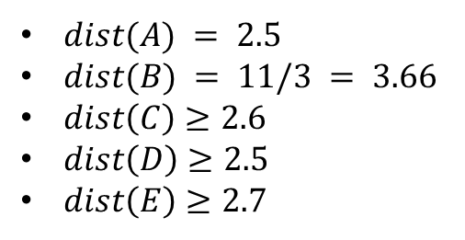

Q5: Computing Distortion in a profile
If $y$ is Pareto, then $dist\left(y\right)=1.$
If $y$ is Condorcet, then $dist(y)<3$.
If there is a Majority winner other than $y$, then $dist(y)>3$.
x2 | x2 | x2 | x1
D | C | B | B
A | A | A | E
E | E | D | C
C | D | E | D
B | B | C | A

Slide 21
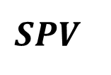
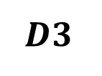

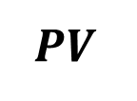
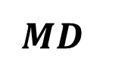
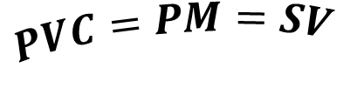
$$C$$
$$D3$$
$$PVC=PM=SV$$
$$MD$$
$$PV$$
$$SPV$$

Slide 22
 | PM | PV | SPV | MD
Distortion 3 | Yes | Yes | Yes | Yes
Condorcet | No | No | No | ?
Majority Fair | Yes | Yes | Yes | Yes
Unanimity Fair | No | Yes | No | Yes
Pareto Efficient | Yes | Yes | Yes | Yes
Monotonic | Yes | Yes | Yes | ?
Spoiler-proof | No | No | No | No
Single-winner | No | Yes | Probably | Probably
Easy to explain | No | Yes | Yes | ?
Anonymous | Yes | No | Yes | Yes

